Slide 1
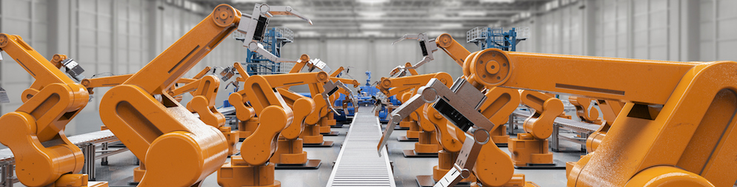
Methodical Approach for Analyzing Process Variables and Optimizing Boundary Conditions in Multi-Axis Robot Programs
Submitted by: Jan Nalivaika Supervised by: Ludwig Siebert (TUM-IWB)
Marius Breuer (Siemens AG)
Jan Nalivaika | Student ID: 03694590 | Siemens T AMC FMP-DE | 2024.03.04

Slide 2
Table of Contents
Motivation
Problem Formulation and Aim
State of the Art
Methodology
Implementation and Results
Discussion
Outlook
Page 1
Jan Nalivaika | Student ID: 03694590 | Siemens T AMC FMP-DE | 2024.03.04

Slide 3
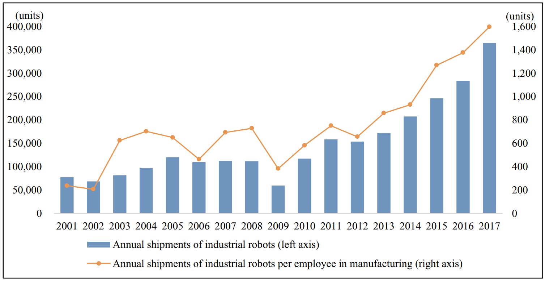
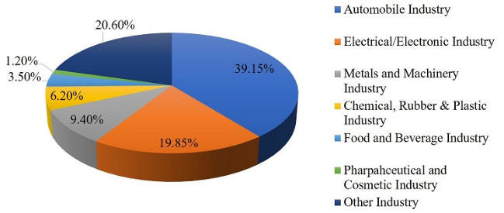
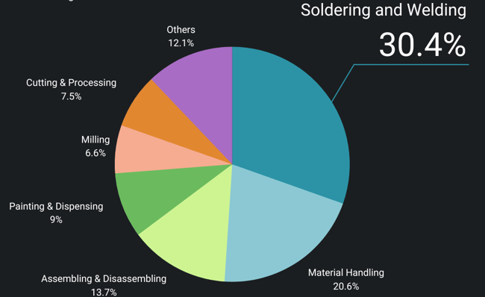
Motivation
(Hwa Jung 2020)
Page 2
Jan Nalivaika | Student ID: 03694590 | Siemens T AMC FMP-DE | 2024.03.04
Notes:
Robots are cool!
Manufacturing advances.
More Data is gathered.
What can we use that data for?

Slide 4

Motivation
(Ni 2021)
Page 2
Jan Nalivaika | Student ID: 03694590 | Siemens T AMC FMP-DE | 2024.03.04
Notes:
Robots are cool!
Manufacturing advances.
More Data is gathered.
What can we use that data for?

Slide 5

Motivation
(Statzon 2024)
Page 2
Jan Nalivaika | Student ID: 03694590 | Siemens T AMC FMP-DE | 2024.03.04
Notes:
Robots are cool!
Manufacturing advances.
More Data is gathered.
What can we use that data for?
How can we use knowledge about the robots to improve their performance?

Slide 6
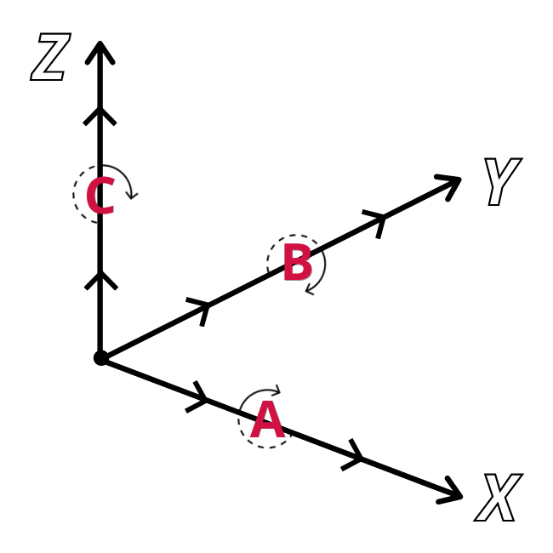
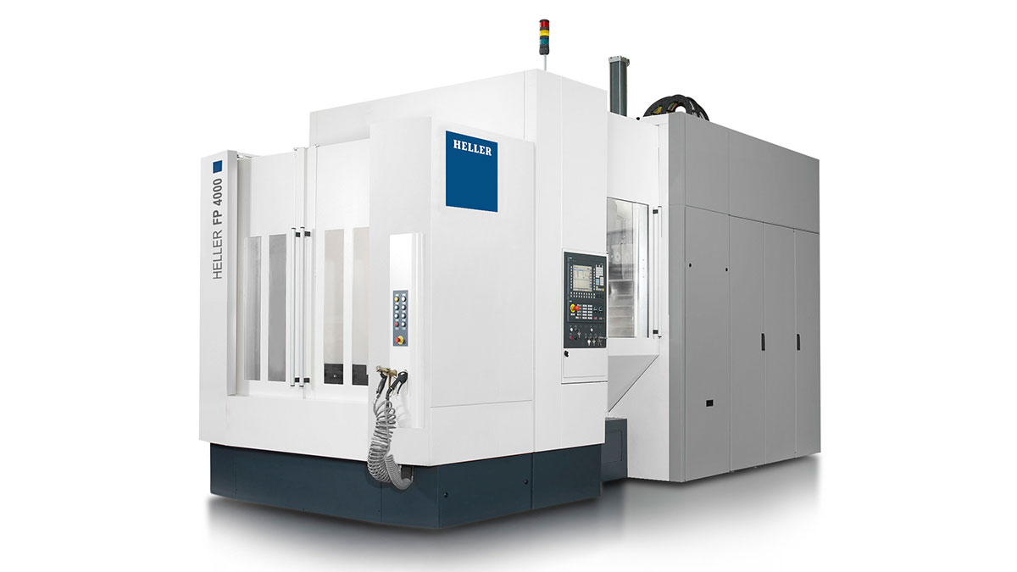
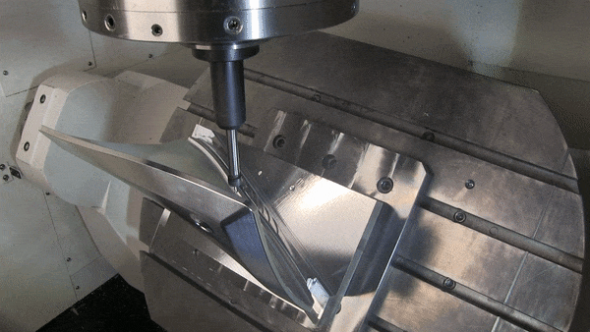
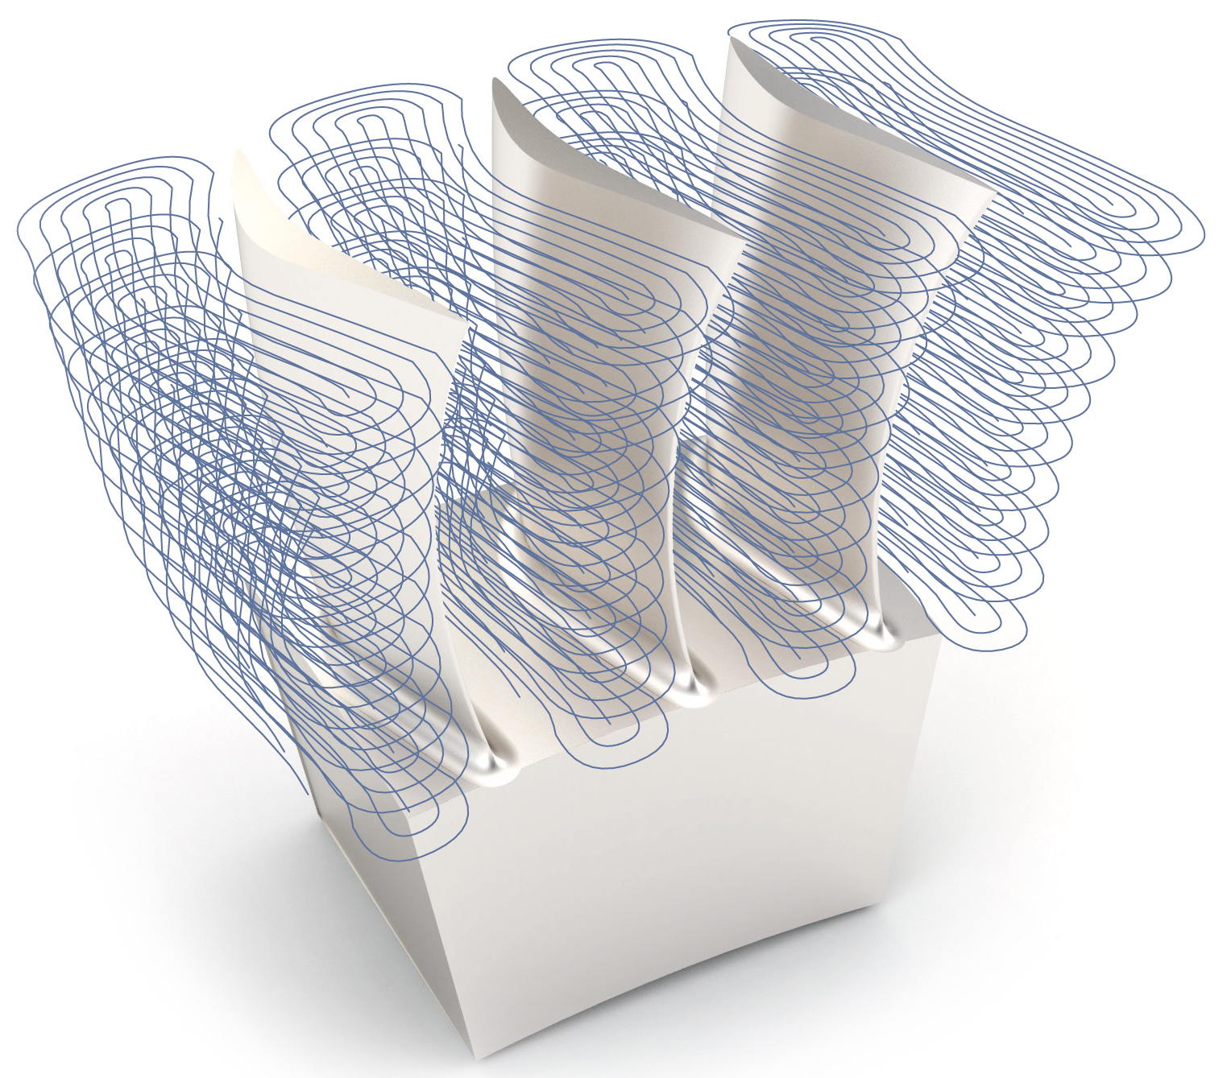
Problem Formulation and Aim (1/4)
In computer numerical control (CNC) milling the traversed toolpaths are usually defined in 5 degrees of freedom (DoFs).
These DoFs are:
X- Y- and Z-coordinates for translation and the rotation A and B
Page 3
Jan Nalivaika | Student ID: 03694590 | Siemens T AMC FMP-DE | 2024.03.04

Slide 7
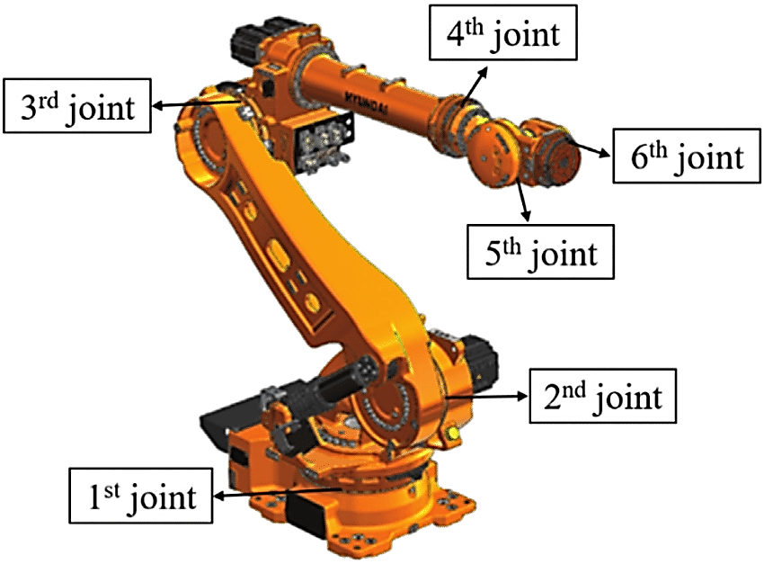
Problem Formulation and Aim (2/4)
Industrial robots:
6 DoFs
great candidate for Wire Arc Additive Manufacturing (WAAM)
can be used for CNC machining
A 5-DoF toolpath does not fully specify the robots configuration.
While the toolpath defines the X, Y, and Z coordinates, as well
as rotations A and B, rotation C is not defined and can be chosen freely.
The rotation C is not affecting the toolpath but the way how this toolpath is traversed. Thus, it is considered a boundary condition.
(Raouf et al. 2022)
Redundancy in the system when performing a 5-Dof task in a 6-DoF system
How does the boundary condition affect the robot and how can we use the redundancy to our advantage?
Raouf et al. 2022
Page 3
Jan Nalivaika | Student ID: 03694590 | Siemens T AMC FMP-DE | 2024.03.04
Notes:
Explain additional redundcy

Slide 8
Problem Formulation and Aim (3/4)
Robot traversing a path with different C rotation:
The different setting of the rotation C (rotation around the axis of the tool) significantly influences the behavior of the robot.
The influenced process variables are for example:
Direction changes in the joints, accelerations, energy consumption, cable positioning
Page 3
Jan Nalivaika | Student ID: 03694590 | Siemens T AMC FMP-DE | 2024.03.04

Slide 9
Problem Formulation and Aim (4/4)
No currently published method allows the user to select specific process variables to evaluate a process
Provide a method that can work with specifically selected process variables and rate a manufacturing process
As of now, it is not possible to weigh individual process parameters and thus describe the manufacturing process as a singular scalar value
Extend the developed method with the option to add user-defined importance factor (weights) for the process variables
No available method provides a solution to optimize boundary conditions based on a user defined goal
Provide system that can optimize the boundary conditions while considering the user defined goal
Page 3
Jan Nalivaika | Student ID: 03694590 | Siemens T AMC FMP-DE | 2024.03.04
Notes:
Problem:
No method present that is adaptable to any system
Not possible to specify desired process parameters
Not possible to weigh individual process parameters
No solution to optimize boundary conditions
Aim:
Develop a system that analyzes process variables
Return a single numerical value describing the process, base on user selected process variables
Present option to optimize boundary condition

Slide 10
State of the Art
Show research gap by comparing what was already done and what is missing
Venn-Diagram
Page 4
Jan Nalivaika | Student ID: 03694590 | Siemens T AMC FMP-DE | 2024.03.04

Slide 11
Methodology
Overview:
1)
Page 5
Jan Nalivaika | Student ID: 03694590 | Siemens T AMC FMP-DE | 2024.03.04

Slide 12
Methodology
Page 5
Jan Nalivaika | Student ID: 03694590 | Siemens T AMC FMP-DE | 2024.03.04

Slide 13
Implementation and Results
Show cool images from modeled robot and results
Show PSO optimization running
Page 6
Jan Nalivaika | Student ID: 03694590 | Siemens T AMC FMP-DE | 2024.03.04

Slide 14
Discussion
Explain why results are good and what can be improved
Page 7
Jan Nalivaika | Student ID: 03694590 | Siemens T AMC FMP-DE | 2024.03.04

Slide 15
Outlook
Show what is possible in the future
Page 8
Jan Nalivaika | Student ID: 03694590 | Siemens T AMC FMP-DE | 2024.03.04

Slide 16
Contact
Jan Nalivaika (TUM) Student Otto-Hahn-Ring 6
81739 Munich, Germany
Phone: +49 1637180148
E-mail: jan.nalivaika.ext@siemens.com nalivaika@outlook.de
Marius Breuer (Siemens AG)
Supervisor Otto-Hahn-Ring 6
81739 Munich, Germany
Phone: +49 1728396287
E-mail: marius.breuer@siemens.com
Ludwig Siebert (TUM-IWB)
Supervisor Boltzmannstr. 15
85748 Garching at Munich
Phone: +49 8928915578
E-mail: ludwig.siebert@iwb.tum.de
Page 9
Jan Nalivaika | Student ID: 03694590 | Siemens T AMC FMP-DE | 2024.03.04

Slide 17
Sources
Jin Hwa Jung 2020: https://www.sciencedirect.com/science/article/pii/S0040162520310283
Jony et al. 2016: https://www.researchgate.net/publication/311323742_Big_Data_Characteristics_Value_Chain_and_Challenges
Jiangnan Ni 2021: https://www.scpe.org/index.php/scpe/article/view/1900
ModuleWorks 2024: https://www.moduleworks.com/moduleworks-and-topsolid-collaborate-on-5-axis-machining/
Raouf et al. 2022: https://academic.oup.com/jcde/article/9/2/417/6537181?login=true
Robot ´milling: https://www.roboticgizmos.com/kuka-robot-foam-art/
CNC mill gif: https://www.precisetool.com/machining-services/5-axis-cnc-machining
Statzon 2024: https://statzon.com/insights/global-industrial-robot-market
Page 10
Jan Nalivaika | Student ID: 03694590 | Siemens T AMC FMP-DE | 2024.03.04

Slide 18
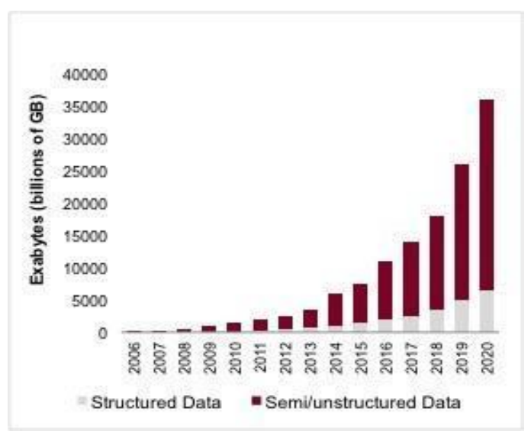
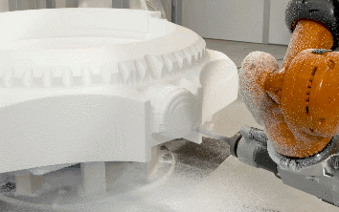
Backup Slide 1
(Jony et al. 2016)
Page 11
Jan Nalivaika | Student ID: 03694590 | Siemens T AMC FMP-DE | 2024.03.04

Slide 19
Backup Slide 2
Page 12
Jan Nalivaika | Student ID: 03694590 | Siemens T AMC FMP-DE | 2024.03.04

Slide 20
Backup Slide 3
Page 13
Jan Nalivaika | Student ID: 03694590 | Siemens T AMC FMP-DE | 2024.03.04

Slide 21
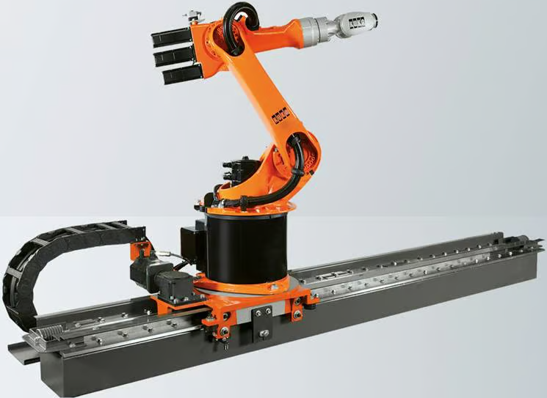
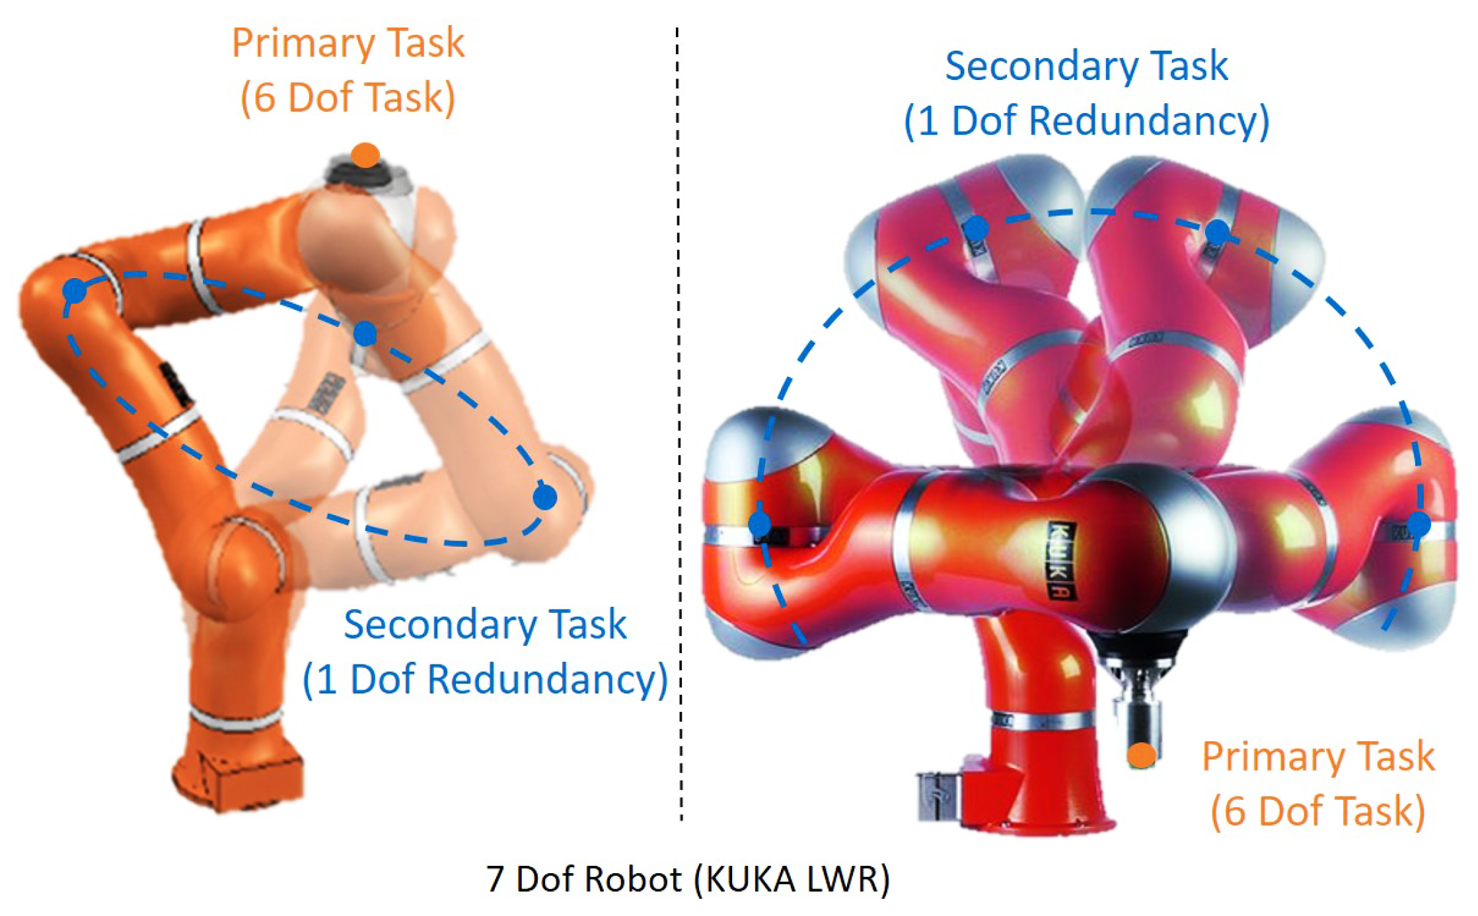
State of the Art
Redundancy: More DoF are present than necessary for a specific task.
Page 4
Jan Nalivaika | Student ID: 03694590 | Siemens T AMC FMP-DE | 2024.03.04

